Slide 1
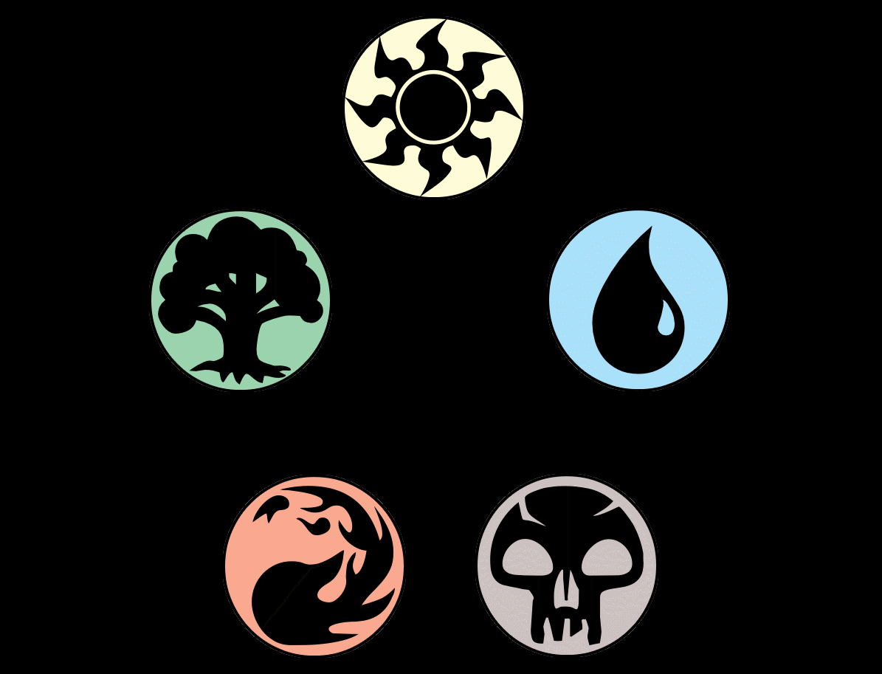

Binary Image Classification: Magic the Gathering Tokens
By: Gabriel Valdes
Ironhack RMT-DAPT-Oct2023

Slide 2
Introduction – Magic the Gathering
Magic the Gathering (MTG) is a fantasy-based strategy card game available in paper and digital formats produced by Wizards of the Coast (WotC).
There are over 25,000 cards printed in the 30+ year history of the game
The vast majority of these cards are “play cards” which players use to construct their decks.
In 2003, WotC began to print “token” cards which are temporary game-pieces created by in-game effects
Notes:
Came out in 1993. WotC now owned by Hasbro.
25000 cards over released 100 sets, of which several are released in a year.
In recent history, MTG has increased its share in the trading card game market by collaborating with different Ips across many different genres. For example (within its own genre) there have been cross overs with other tabletop games such as Warhammer and Dungeon and Dragon sets. Moreover, there have been special sets and cards that feature Transformers, Jurassic Park, Street Fighter, Stranger Things and even Princess Bride.

Slide 3

Business Case
Recently hired at startup online retailer for MTG as data scientist.
The business is buying as many cards as possible in bulk from eBay and similar platforms.
In the thousands of cards purchased, many will be tokens which are not as highly valued as they are not used to construct decks.
The business scans the newly purchased card and has enlisted me to create a classification model to be able to tell what in their stock is a play card versus a token.

Slide 4
Approach
Gather images of play cards and token images
Load and arrange images into training and testing data sets and then apply digital transformations to the images
Define an image classification model and determine the accuracy of the model
Use predefined models to compare accuracy to my own
Attain more images of different types of cards to test the accuracy of each model

Slide 5
Gathering Card Images
Technique used: Webscraping
Website: Scryfall.com search result page(s)
Results for “token” type of cards (13 pages)
Results for “commander legal” play cards (444 pages)
Images were saved locally to specified test and train folders using Python code.
Notes:
Web scraping is the process of collecting and parsing raw data from a web site’s HTML code. Using the Inspect feature of my browser I was able to locate the hosted URL of each image on the search result page in the HTML code. My function would take the URLs, read the image and save it as a local file on my PC. I used a library called “os” to also create folders within the test and train folders for each subset of image (token vs play card) and move the respective images to the correct folder.

Slide 6
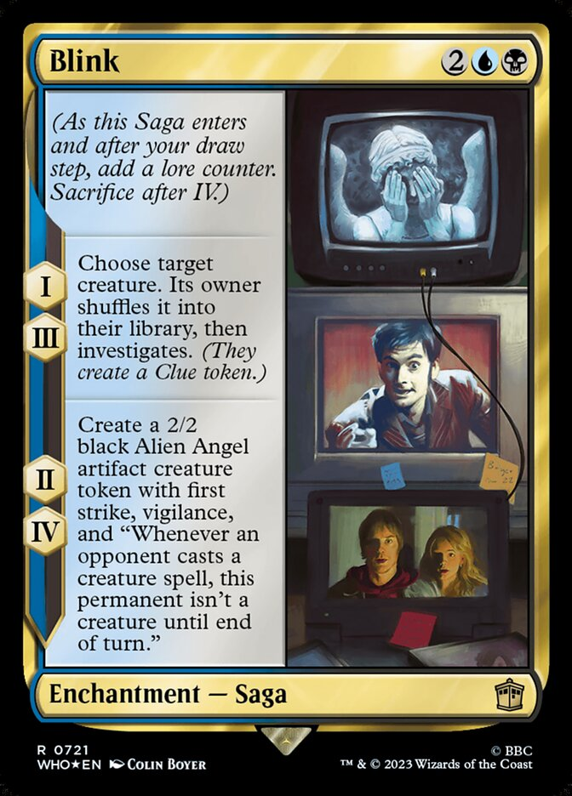
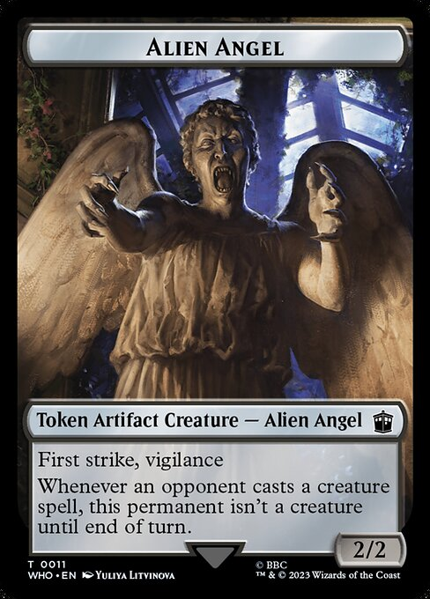
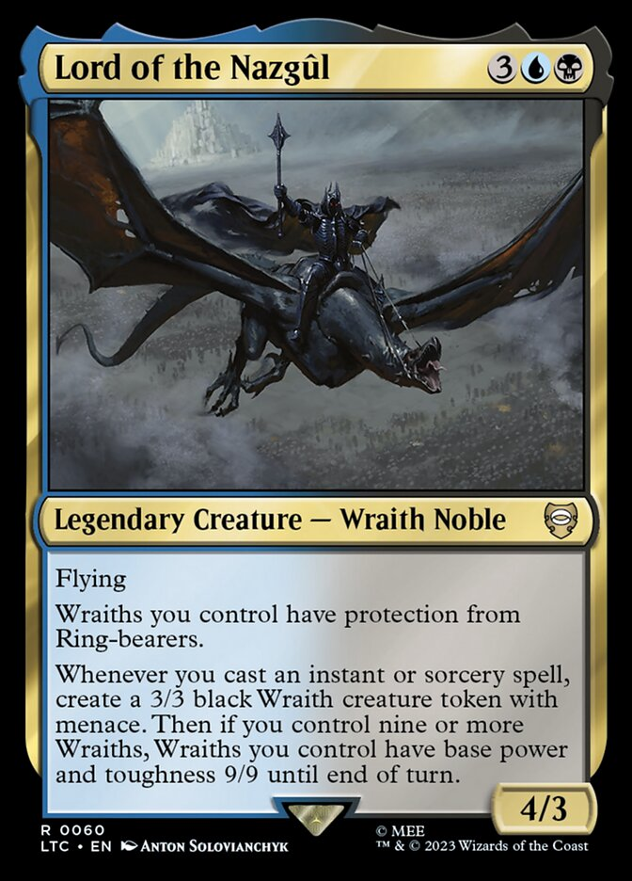
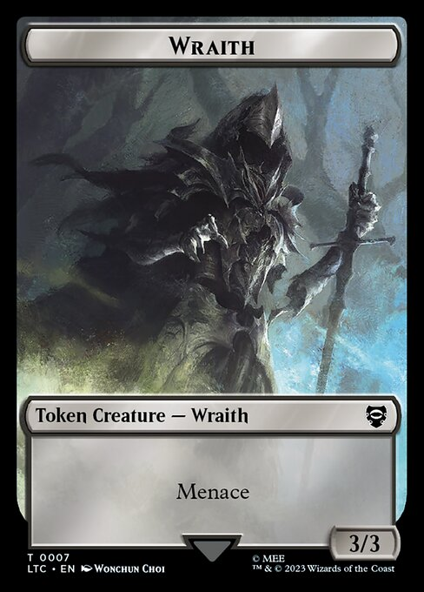
Gathering Card Images
Result:
Training data set
Scraped Play Card images: 1,157
Scraped Token Images: 454
Testing data set
Scraped Play Card images: 978
Scraped Token Images: 244
Notes:
Totals : 2100+ play, 698 tokens
To demonstrate what I mean when talking about play cards vs tokens I provided these images here from real MTG cards. The 1st pair show cards from the Dr. Who set released last year. The image on the left is a play card named “Blink”. You can see that it has things like a “mana cost”, which must be paid in-game in order to cast the spell. If we focus on the last paragraph, you can see that the card’s ability allows the player to “create a 2/2 black Angel Alien artifact token” with various abilities, which you can see is the next image. This token card has no mana cost (because players cannot cast this card, it can only be created by another card’s effect). This is one of the main differences between the cards and one of the nuisances that my model can use to determine whether a given image is of a token or play card. Moving on to our other example, another main distinction is in the “type line” of the cards. Lord of the Nazgul has Legendary Creature as its super type and Wraith Noble subtype. All token cards, contain the super type “token:.

Slide 7
Fixing Data Imbalance & Augmenting Images
Data Imbalance: The bias that exists when one class of data outnumbers another class may lead to an inaccurate model.
Digital Augmentation: Applying various effects to images allowed me to randomly adjust basic attributes of the image like:
contrast and brightness.
vertical flipping, rotation, zoom and crop.
Notes:
Based on the results from the previous slide, it is easy to see that there was a high data imbalance. I had extracted every single printed token card image and had about 700 records, however I had over 3 times the amount of play card images only scraping about 30 pages of play card search results. This means that my model could learn more easily about features of play cards than token cards since there were more present in my data set. Another problem I wanted to solve was card quality. It is completely plausible that during the bulk purchases of the cards there would vastly differing quality of cards purchased, for example, brand new cards, faded cards, scratched cards, bent cards, etc. Another “real world” aspect I wanted to account for was how scanning the images might not always be uniform, some may be fed into the scanner upside down, or slightly off axis. I was able to solve both these problems by using digital augmentation. As I was building the actual training data from the images I captured, for each token image I stored 3 copies of the image, two with differing sets of random augmentation and then the original. For the play cards, I augmented only a fraction of the images I was constructing my test data from.

Slide 8
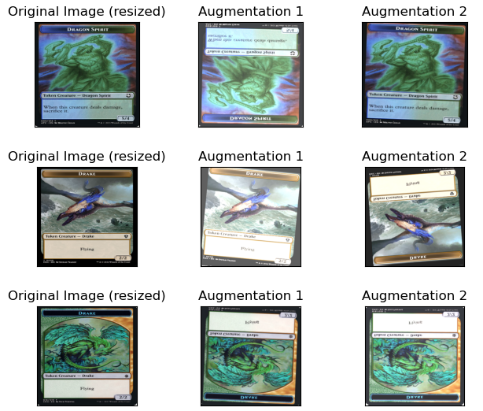
Augmentation Results
Final training data set size: 2,849 images
Scraped Play Card images: 1,487 ( + 28%)
Scraped Token Images: 1,362 (+ 200%)
Notes:
Here are the results of the custom data image augmentation I did. I was able to increase my token image samples by 200% and fixed the data imbalance present in my training data.
You can also see here an example of how the augmentations affected the images

Slide 9
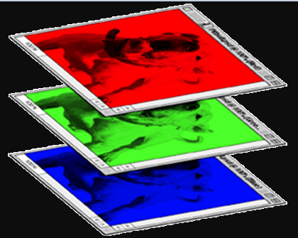
Images as Data
Machine Learning cannot be achieved from visually interpreting images as humans can. Instead, the images are converted into arrays of data, and the machine learns patterns from these arrays.
Color image
1 | 0 | 0 | 0 | 0 | 1
0 | 1 | 0 | 0 | 1 | 0
0 | 0 | 1 | 1 | 0 | 0
1 | 0 | 0 | 0 | 1 | 0
0 | 1 | 0 | 0 | 1 | 0
0 | 0 | 1 | 0 | 1 | 0
1 | 0 | 0 | 0 | 0 | 1
0 | 1 | 0 | 0 | 1 | 0
0 | 0 | 1 | 1 | 0 | 0
1 | 0 | 0 | 0 | 1 | 0
0 | 1 | 0 | 0 | 1 | 0
0 | 0 | 1 | 0 | 1 | 0
1 | 0 | 0 | 0 | 0 | 1
0 | 1 | 0 | 0 | 1 | 0
0 | 0 | 1 | 1 | 0 | 0
1 | 0 | 0 | 0 | 1 | 0
0 | 1 | 0 | 0 | 1 | 0
0 | 0 | 1 | 0 | 1 | 0
Notes:
Each pixel of each color-layer of the image is converted to a value between 0 and 255 depending on the pigment on the pixel (255 being the most saturated). The original size of the scraped images was 488 x 680 so the array of data created for each image had the shape (488 x 680 x 3). I reduced the size of the image to 366 x 366 so that the images would be perfect quadrilaterals (or squares) to make them easier for the machine to interpret and learn from. I also scaled down the values of the arrays to be decimals between 0 and 1 which also helps to reduce the complexity of the data.

Slide 10
Convolutional Neural Networks
Deep learning is an effective tool for analyzing large quantities of data by using complex algorithms to train machines/computers
These models help machines learn from repeated exposure to training data and make predictions on new data presented to the model
Convolutional Neural Networks accept the pixel-array as an input
https://www.happiestminds.com/insights/convolutional-neural-networks-cnns/#:~:text=Within%20Deep%20Learning%2C%20a%20Convolutional,image%2Fobject%20recognition%20and%20classification.
Notes:
The “deep” aspect comes from the many layers of computation that take place on models that are very complex.
The term Neural Network is derived from the architecture of our brains and how neurons are passed between certain synapses dependiding on

